Slide 1
Chapter 14: IBM Cognitive Computing
Exploring IBM's AI-Driven Cognitive Solutions

Slide 2
What is Cognitive Computing?
• Simulates human thought processes using AI and machine learning.
• Uses data analytics, NLP, and neural networks.
• Aims to improve decision-making and automate complex tasks.

Slide 3
What is IBM Cognitive Computing?
IBM Cognitive Computing refers to AI-driven solutions that simulate human thought processes.
Uses IBM Watson and AI technologies to analyze and process large amounts of data.
Aims to enhance decision-making, problem-solving, and automation.

Slide 4
IBM Watson: The Power Behind Cognitive Computing
A powerful AI system that processes and understands natural language.
Uses machine learning, NLP, and deep learning for data analysis.
Provides insights and recommendations for various industries.

Slide 5
Technologies Behind Cognitive Computing
Artificial Intelligence (AI)
Machine Learning (ML)
Neural Networks
Big Data & Analytics
Internet of Things (IoT)

Slide 6
Key Features of IBM Cognitive Computing
• Natural Language Processing (NLP): Understands and responds to human language.
• Machine Learning: Learns from data and improves over time.
• Big Data Analysis: Processes vast amounts of structured and unstructured data.
• Cloud Integration: Offers AI services through IBM Cloud.
• Human-AI Collaboration: Works alongside humans for better decision-making.

Slide 7
Applications of IBM Cognitive Computing
• Healthcare: Diagnosing diseases, personalized treatment, drug discovery.
• Finance: Fraud detection, risk analysis, automated customer support.
• Retail: AI-driven recommendations, personalized shopping experiences.
• Manufacturing: Predictive maintenance, process optimization.
• Cyber security: AI-powered threat detection and prevention.

Slide 8
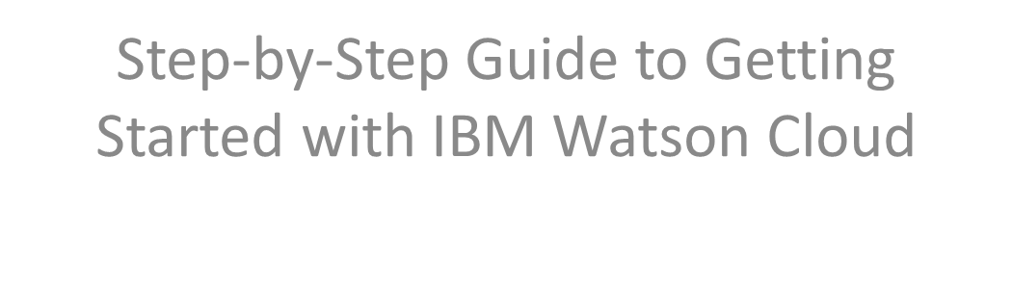
How to Create an Account on IBM Watson Cloud

Slide 9
What is IBM Watson Cloud?
IBM Watson Cloud provides AI-powered cloud services.
Includes machine learning, NLP, and data analytics tools.
Offers various AI services for businesses and developers.

Slide 10
Prerequisites for Creating an Account
• A valid email address.
• A web browser (Chrome, Firefox, Edge, or Safari).
• Internet access.
• (Optional) Payment details if signing up for a paid plan.

Slide 11
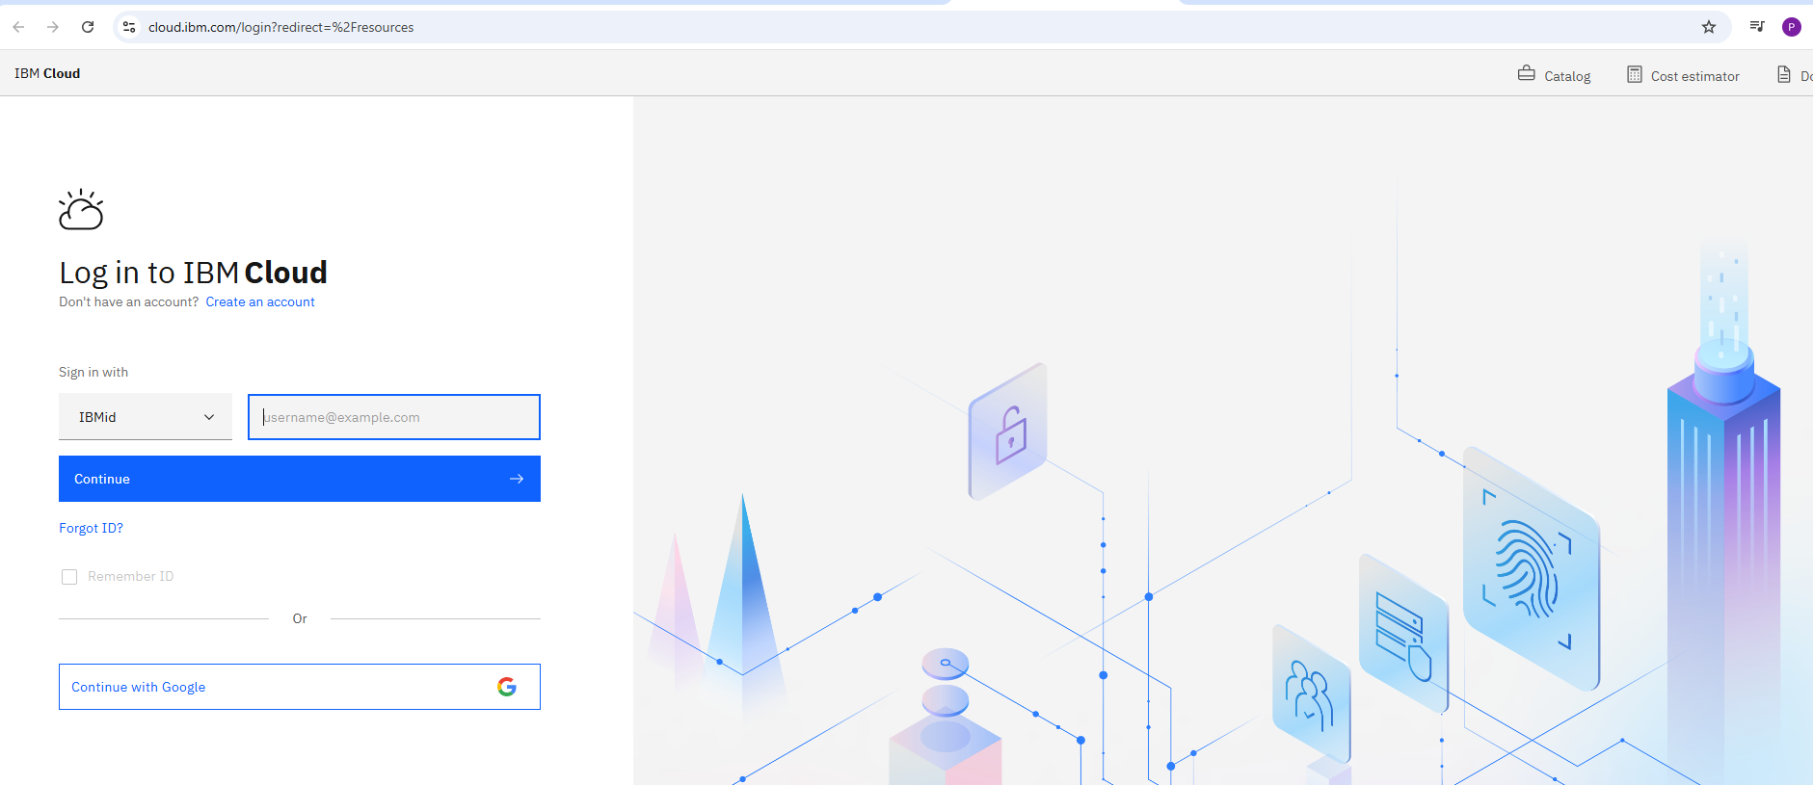
Step 1: Visit the IBM Cloud Website
Open a web browser and go to: https://cloud.ibm.com
Click on **'Create an IBM Cloud Account'**.
You will be redirected to the sign-up page.

Slide 12
Step 2: Enter Your Details
• Provide your **email address**.
• Enter a **strong password**.
• Fill in your **first and last name**.
• Select your **country/region**.

Slide 13
Step 3: Verify Your Email Address
• IBM will send a verification email.
• Open your email inbox and find the email from IBM.
• Click on the verification link to confirm your account.

Slide 14
Step 4: Complete Your Profile
Sign in to IBM Cloud with your verified email.
Enter additional details such as phone number (optional).
Choose a **free** or **paid** plan based on your needs.

Slide 15
Step 5: Start Using IBM Watson Services
Once signed in, go to the IBM Cloud dashboard.
Navigate to the **IBM Watson** section.
Explore AI tools like Watson Assistant, NLP, and Watson Studio.
List of services https://cloud.ibm.com/catalog#highlights

Slide 16
Troubleshooting & Support
If you don’t receive the verification email, check your spam folder.
If you face issues signing up, visit IBM Support: https://www.ibm.com/cloud/support
Contact IBM Cloud customer service for further assistance.

Slide 17
Conclusion
IBM Watson Cloud offers powerful AI-driven solutions.
Creating an account is easy and provides access to free AI tools.
Start exploring Watson AI services today!

